Slide 1
Introduction to Lisp
CS161 Discussion 1
Sidi Lu 10/01/2021
(original credit to: Jinghao Zhao, 10/09/2020)

Slide 2
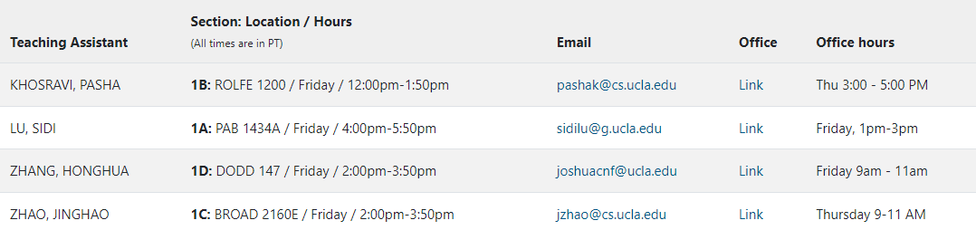
Logistics
Syllabus: https://web.cs.ucla.edu/~guyvdb/teaching/cs161/2021f/
Office hour
Grading
Homework 20% (one-week deadline. The late policy subtracts 25% of the total points for each day you submit late.)
Midterm 35%
Final 45%

Slide 3
Background
What is Lisp?
Originally specified in 1958 by John McCarthy , Lisp is the second-oldest high-level programming language
Functional programming language
Why do we use it in this class?
Common Lisp
The modern, multi-paradigm, high-performance, compiled, ANSI-standardized, most prominent descendant of the long-running family of Lisp programming languages.
Object oriented programming and fast prototyping capabilities
Notes:
oldest: Fortran
lisp is the AI language since 1980s
lisp is popular for traditional AI programming because it supports symbolic computation very well
many dialects

Slide 4
Using Clisp Online/Offline
Cloud Service via SEASANet:
https://www.seasnet.ucla.edu/apply-for-student-account/
ssh -X lnxsrv.seas.ucla.edu -l yourseasaccountname
Interactive mode
clisp
Load from file
clisp "./hw1.lsp“
SSH Environment:
Windows OS: use putty/WSL for ssh
https://www.chiark.greenend.org.uk/~sgtatham/putty/
https://docs.microsoft.com/en-us/windows/wsl/install
Linux/WSL: apt install clisp
For MacOS: you can also use brew install clisp to install it locally.
(load “test.lsp”)
(exit)

Slide 5
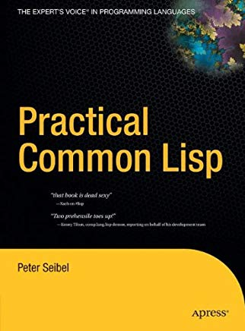
Useful links
CLISP
CLISP implements the language described in the ANSI Common Lisp standard with many extensions.
https://clisp.sourceforge.io/
You can also access it from SEASnet
Try Lisp online:
https://jscl-project.github.io/
Practical Common Lisp (Book)
http://www.gigamonkeys.com/book/

Slide 6
Syntax
Two fundamental pieces
ATOM
S-EXPRESSION.

Slide 7
Atom
comment
30 ; => 30
"Hello!" ; string
t ; denoting true
nil ; false; the empty list: ()
:A ; symbol
A ; Error. Not defined
any non-NIL value is true!
Notes:
冒号：colon
Symbols start with a colon
分号：semi colon
Comments start with semi colon)\

Slide 8
Atom
9999999999999999999999 ; integer
#b111 ; binary => 7
#x111 ; hexadecimal => 273
3.14159s0 ; single
3.14159d0 ; double
1/2 ; ratios
#C(1 2) ; complex numbers

Slide 9
s-expression: super simple, super elegant
(f x y z ...)
(+ 1 2 3 4) ; 1+2+3+4 => 10
(atom 1) ; T
Use quote or ' to prevent it from being evaluated (lazy calculated)
'(+ 1 2) ; => (+ 1 2)
(quote (+ 1 2)) ; => (+ 1 2)
'(1 2 3) ; list (1 2 3)
Use eval to de-quote those lazy calculated expressions
(eval '(+ 1 2)) ; => 3
function
arguments
Notes:
s-expressions are wrapped by brackets
s: symbolic
单引号 a’postrophe
Why s-expression is good
function and operators
(+ 1 2)
(add 1 2)
(exp 1 3)
（if so then else)
pow(1, 3)
1+2
2. No ambiguity. No operator priority. Very easy to parse abstract syntax tree
3+4*7/5
(+ 3 (/ (* 4 7) 5))
3. Simple but coming with great expressive power
(+ 10 (if test 1 2)) C++: test?1:2
Switch(x)
{ case a: ... break;}
(cond ((case) (then)) }

Slide 10
Basic arithmetic operations
(+ 1 1) ; => 2
(- 8 1) ; => 7
(* 10 2) ; => 20
(expt 2 3) ; => 8
(mod 5 2) ; => 1
(/ 35 5) ; => 7
(/ 1 3) ; => 1/3
(+ #C(1 2) #C(6 -4)) ; => #C(7 -2)
Notes:
expt: exponential

Slide 11
Booleans and Equality
(not nil) ; => T
(and 0 t) ; => T
(or 0 nil) ; => 0
(and 1 ()) ; => 0
empty list
Notes:
Logic of and/or?

Slide 12
Booleans and Equality
compare numbers
(= 3 3.0) ; => T
(= 2 1) ; => NIL
(eql 3 3) ; => T
(eql 3 3.0) ; => NIL
(eql (list 3) (list 3)) ; => NIL
(equal (list 'a 'b) (list 'a 'b)) ; => T
(equal (list 'a 'b) (list 'b 'a)) ; => NIL
compare object identity
compare lists, strings
Notes:
等号 equal sign
If we don't add the apostrophe before a and b, lisp will try to evaluate the expression and find it's not defined. Then it will throw an error

Slide 13
Strings
type
(concatenate 'string "Hello," "world!") ; => "Hello,world!"
(format nil "Hello, ~a" "Alice") ; returns "Hello, Alice"
(format t "Hello, ~a" "Alice")
(print "hello") ; value is returned and printed to std out
(+ 1 (print 2)) ; prints 2. returns 3.
; returns nil. formatted string goes to standard output
Notes:
format similar to printf
波浪号 tilde
~a: string
~d: integer
~,2f: float

Slide 14
Variables
global (dynamically scoped) variable
The variable name can use any character except: ()",'`;#|\
(defparameter age 35)
age ; => 35
name ; error
(defparameter *city* "LA")
*city* ; => "LA"
Notes:
Variable names are usually wrapped by asterisks. But it doesn't have to be so

Slide 15
Variables
(defparameter age 35) ; age => 35
(defparameter age 60) ; age => 60
(defvar newage 20) ; newage => 20
(defvar newage 60) ; newage => 20
(setq newage 30) ; newage => 30
defvar does not change the value of the variable!
Notes:
If you use setq on a variable before you define the variable, you will be able to set it. But you will receive a warning about undefined variable. It's not recommended

Slide 16
Local variable
(let ( (a 1) (b 2) ) ; binding
(+ a b) ; body
)
You will NOT be allowed to set global variables in your homework!
let only

Slide 17
Lists
Linked-list data structures
Made of CONS pairs
(cons 1 2) ; => '(1 2)
(cons 3 nil) ; => '(3)
(cons 1 (cons 2 (cons 3 nil))) ; => '(1 2 3)
(list 1 2 3) ; => '(1 2 3)
(cons 4 '(1 2 3)) ; => '(4 1 2 3)
(cons '(4 5) '(1 2 3)) ; => ?
Notes:
CONS are used to construct pairs
If the second argument is a list, CONS would take the first argument as the first item and second argument as the rest of the list
( (4 5) 1 2 3)

Slide 18
Lists
(cons 1 (cons 2 (cons 3 nil))) ; => '(1 2 3)
(list 1 2 3) ; => '(1 2 3)
(cons 4 '(1 2 3)) ; => '(4 1 2 3)
(cons '(4 5) '(1 2 3)) ; => '((4 5) 1 2 3)
(append '(1 2) '(3 4)) ; => '(1 2 3 4)
(append 1 '(1 2)) ; ERROR!
(append '(1) '(2 3)) ; => '(1 2 3)
(concatenate 'list '(1 2) '(3 4)) ; => '(1 2 3 4)
(car '(1 2 3 4)) ; => 1
(cdr '(1 2 3 4)) ; => '(2 3 4)
car and cdr should be used for list, you can also use first/rest
Notes:
CONS are used to construct pairs.
If the second argument is a list, CONS would take the first argument as the first item and second argument as the rest of the list
CAR stands for "Copy Address Register"
CDR stands for "Copy Decrement Register"

Slide 19
Functions
Define a function
(defun hello (name) (format nil "Hello, ~A" name))
Call the function
(hello "Bob") ; => "Hello, Bob"

Slide 20
Control Flow
(if (equal *name* "bob") ; test expression
"ok" ; then expression
"no") ; else expression
Chains of tests: cond
(cond ((> *age* 20) "Older than 20")
((< *age* 20) "Younger than 20")
(t "Exactly 20"))
(cond ((> *age* 20) "Older than 20")
((< *age* 20) "Younger than 20")) ; returns NIL when *age*=20

Slide 21
Programming Practice!
Factorial
compute list length
find kth element
check if list contains a number
delete kth element

Slide 22
Recursion - factorial
(defun factorial (n)
(if (< n 2)
1 ; returns 1 when n<2
(* n (factorial (- n 1))) ; when n>=2
)
)
(factorial 5) ; => 120

Slide 23
Recursion – compute list length (top-level)
'((a b) (c (d 1)) e) => 3
(defun listlength (x)
(if (not x) ; base case: empty list
0
(+ (listlength (cdr x)) 1)
)
)
'(1 2 3 4) -> '(2 3 4)

Slide 24
Recursion – compute list length (deep)
'((a b) (c (d 1)) e) => 6
(defun deeplength (x)
(cond ((not x) 0) ; empty list. returns 0
((atom x) 1) ; atom. returns 1
(t (+ (deeplength (car x)) ; else
(deeplength (cdr x))
)
)
)
)

Slide 25
Recursion – check if list contains an element
(defun contains (e x)
(cond ((not x) nil)
((atom x) (equal e x))
(t (or (contains e (car x)) (contains e (cdr x))))
)
)
(contains 'a '((b a) (1 e c)))

Slide 26
Recursion – check if list contains a number
Consider this case: '((a b) (c (d 1)) e)
(defun contains_number (x)
(if (atom x) ; NIL if x is a list
(numberp x) ; numberp: check if x is a number
(or (contains_number (car x))
(contains_number (cdr x)) ; recursively flatten
)
)
)

Slide 27
Recursion – find kth element (top-level)
(defun find_kth (k x)
(if (= k 1)
(car x)
(find_kth (- k 1) (cdr x))
)
)
How do we find kth element in the flattened list?
3, '((a b) (c (d 1)) e) => c

Slide 28
Flatten a nested list
(defun flatten (l)
(if (eql l nil)
nil
(let ((elem (car l)) (restl (cdr l)))
(if (listp elem)
(append (flatten elem) (flatten restl))
(append (cons elem nil) (flatten restl))))))

Slide 29
Recursion – delete kth element
(defun delete_kth (k x)
(if (= k 1)
(cdr x)
(cons (car x)
(delete_kth (- k 1) (cdr x))
)
)
)

